Slide 1

Osmosis - the inside story
By

Slide 2


Hi there.
Cillus is the name.
Baz Cillus - animated reporter for BioNews.
I’m going to show you how plants take in water.

Slide 3

I am well qualified for this job.
I’m a bacterium who lives in the soil with millions of my relatives.
I’m tiny enough to get right inside cells – AND
Here in my hand I have an artistic licence!
This guarantees I can change size, simplify things and hopefully make it easy to understand.

Slide 4

So let’s get started.
Here I am standing on a dry bit of soil.
Notice the air gaps between the soil particles.
These allow roots to get oxygen.

Slide 5

Of course soil particles are usually surrounded by water.
It could be a thin film of water like this ……

Slide 6
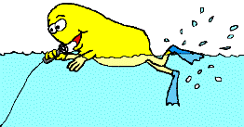
Or a deep layer that largely fills the gaps – like this!

Slide 7

Before we find out just how this water gets into plants, we are going to look at a diagram of a plant root tip.

Slide 8
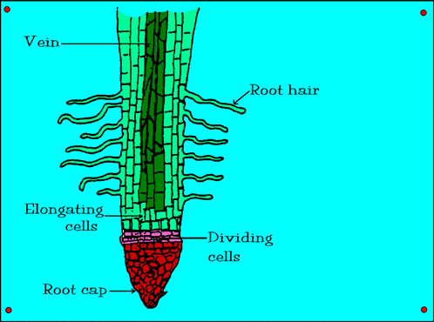

This is a diagram of a root tip.
The root hairs greatly increase the surface area over which the plant can absorb water.
Now we are going back to the soil in between these root hairs for a close up look.

Slide 9
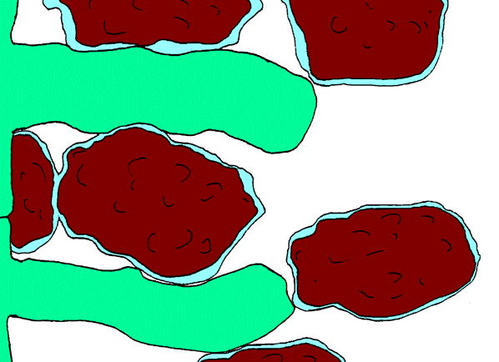

Here we are among some root hairs. Notice their contact with the water film around the soil.
Remember that their job is to increase the surface area over which roots can absorb water.
Now I’m going to shrink down to a tiny size so we can study the surface of a root hair.

Slide 10
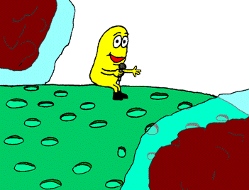
I am now sitting on a root hair.
Notice these small holes in the outer membrane of the hair.
These are called pores.

Slide 11
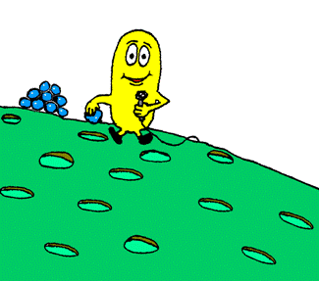
See how this water particle can fit through the pores.
Water particles are always moving in and out of the pores.

Slide 12
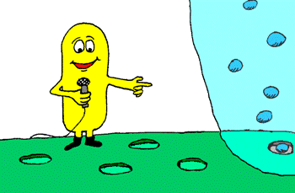
See the water particles in that film of water.
They are constantly moving.
Some going in and some coming out of the pores.
I want to go in there, but first I’m going to have to shrink down and put on some gear.
Meet you back here soon!

Slide 13
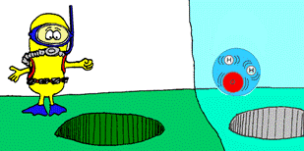
Ok – I’m ready!
Got my scuba gear with a built in microphone, so off we go!

Slide 14
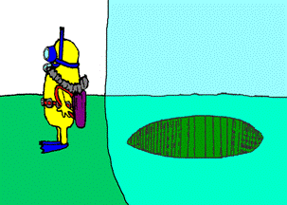
Banzai !!!

Slide 15
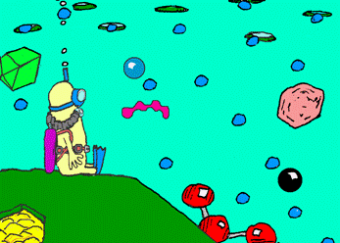
Look at all the particles moving around.
The small water particles can enter and leave through the pores, but those sugar, protein and other ones are too big.
Keep in mind that big particles take up a lot of room in the cell, meaning there is less room in the cell for water particles.

Slide 16
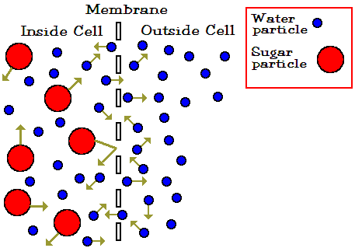
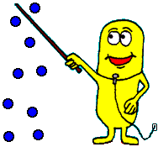
Now it stands to reason that there are more water particles outside of the cell membrane than inside of it.
So – since the particles are always moving around, more particles will move into the root hair than will move out – unless the cell is really full that is.

Slide 17
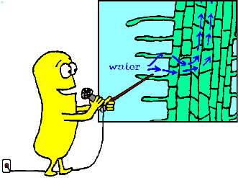
But the cell will never become full because the water moves further in and then up the veins in the middle of the root.
That explains how water gets in – BUT!

Slide 18

I am now going to make myself unpopular by wheeling out some of those nasty big words that scientists like to make up.

Slide 19

Ok, lets see what…. Oops – who put that in here?
This word looks more promising, let’s learn about diffusion.

Slide 20
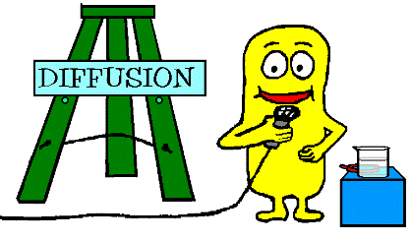
Diffusion
I can best show diffusion by dropping this crystal into a beaker of water…..

Slide 21

Diffusion
You saw the crystal dissolve.
It broke up to smaller and smaller particles which spread out from where there were more of them, to areas where there were fewer of them.
After a few hours they will have spread evenly through the water.
This is called diffusion and it helps plants take in water and other substances.

Slide 22
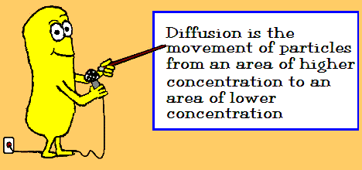
Diffusion
Now carefully read my summary of diffusion below.

Slide 23
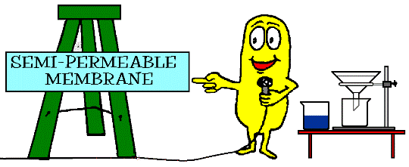
Semi-permeable membranes
I’m going to explain semi-permeable membranes, but first I will explain permeable using this gear here.

Slide 24
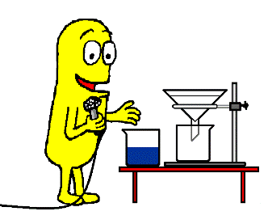
See how the coloured solution goes right through the filter paper.
The paper is permeable to the water and to the crystal particles in it.
Permeable means water and dissolved particles can pass through it.

Slide 25
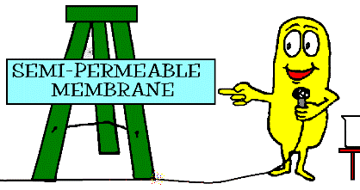
And so back to this. “Semi“ means half or partly.
So if something is semi-permeable, it is only partly permeable – only some things can go through it.

Slide 26
Remember how a cell membrane will let only water particles through it?
It is semi-permeable.

Slide 27
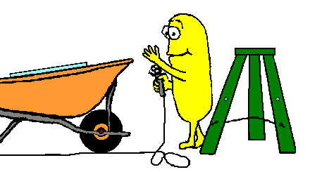
So we now get to this important word.

Slide 28
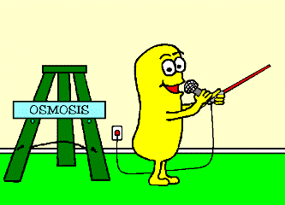
Osmosis
Osmosis is the diffusion of water particles from an area of high water concentration to an area of low water concentration through a semi-permeable membrane

Slide 29
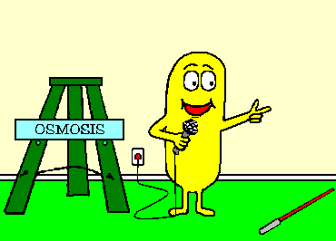
Osmosis is the diffusion of water particles from an area of high water concentration to an area of low water concentration through a semi-permeable membrane
And now it is the time for you to do some work.
Use the worksheet provided to keep a record of what you have learned.

